Slide 1
Software Engineering Principles

Slide 2
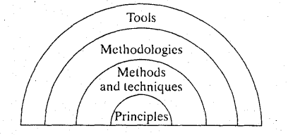
Principles in Software Development Process

Slide 3
Rigor and Formality
Precision and exactness
  Repeatedly produce reliable products
  Control costs of the products
  Increase confidence in reliability of the products
Highest degree of rigor is formality
  Use of mathematical laws to derive and evaluate the software process.
See Chapter 3 of Ghezzi

Slide 4
Rigor and Formality
Has beneficial effects on:
  Reliability
  Verifiability
  Maintainability
  Reusability
  Portability
  Understandability
  Interoperability
See Chapter 3 of Ghezzi

Slide 5
Separation of Concerns
Requirements Analysis | Design | Coding | Testing | Deployment | Maintenance
Time
Qualities
Views
Parts
Management vs Technical
Problem-domain concerns vs implementation-domain concerns
See Chapter 3 of Ghezzi, Chapter 1 of Hamlet

Slide 6
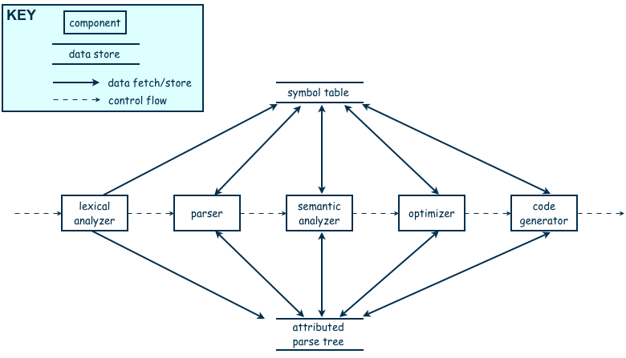
Modularity
Quiz System
Student sub System
Submission Management
Decomposability
Composability
Submission Verification
Submission Storage
Quiz Conduction and Display
Faculty sub System
User Management
Quiz Management
Quiz Generation
Question Management
Report Management
Grading
See Chapter 3 of Ghezzi, Chapter 2 of Hamlet
Attempt Reporting

Slide 7
Modularity
Modularity is the principle of keeping the unrelated aspects of a system separate from each other,
  each aspect can be studied in isolation (also called separation of concerns)
If the principle is applied well, each resulting module will have a single purpose and will be relatively independent of the others
  each module will be easy to understand and develop
  easier to locate faults
    because there are fewer suspect modules per fault
  Easier to change the system
    because a change to one module affects relatively few other modules
To determine how well a design separates concerns, we use two concepts that measure module independence: coupling and cohesion
Single responsibility principle

Slide 8
Modularity: coupling
Two modules are tightly coupled when they depend a great deal on each other
Loosely coupled modules have some dependence, but their interconnections are weak
Uncoupled modules have no interconnections at all; they are completely unrelated
Uncoupled -
no dependencies
Loosely coupled -
some dependencies
Tightly coupled -
many dependencies

Slide 9
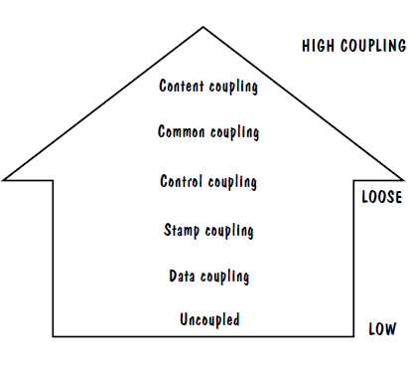
Modularity
bool act(int x){
if (x == 0)
return false;
else
return true;
}
void call(){
// Calling act() by passing a value which controls its flow:
act(1);
}
Coupling
  Control
  Common
  Routine call
  Data
  Content coupling
  Type-Use
  Stamp
  Import
class A{
// Code for class A.
};
class B{
// Data member of class A type: Type-use coupling
A var;
// Argument of type A: Stamp coupling
void calculate(A data){
// Do something.
}
};
High coupling is NOT desired

Slide 10
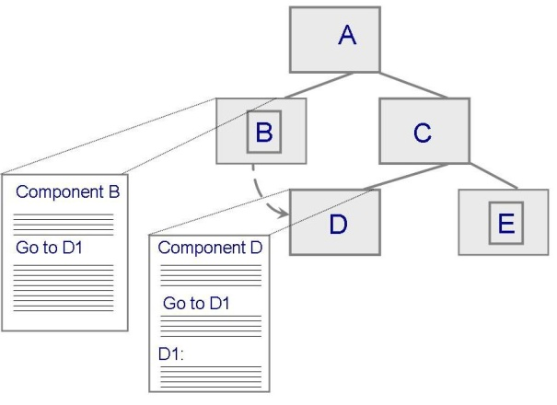
Modularity: Coupling: Content Coupling
One component modifies an internal data item of another component, a component (e.g. B) branches into another component (e.g. D)
Set a private data member of another module?
Module B
_________________
_________________
_________________
_________________
Goto D1
_________________
_________________
_________________
_________________
_________________
_________________
_________________
_________________
Module D
_________________
_________________
_________________
_________________
_________________
_________________
D1:
_______________
_________________
_________________
_________________

Slide 11
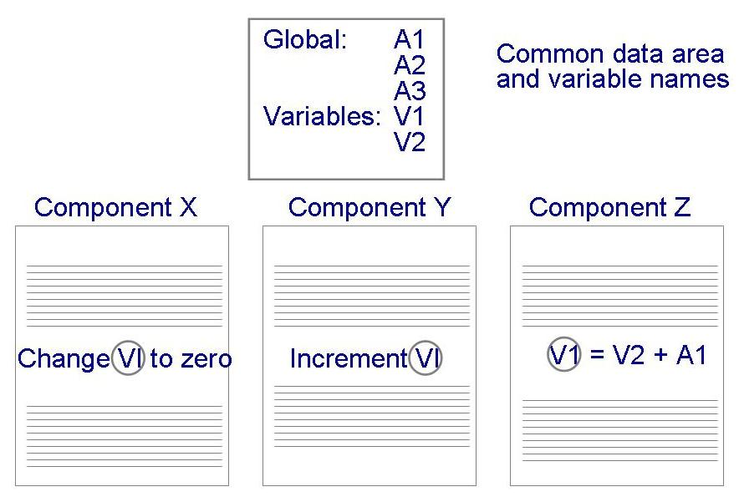
Modularity: Coupling: Common Coupling
Dependency due to common data. Which component is responsible to set a particular value for the common variable?
  Tracing back to all components that access those data to evaluate the effect of the change

Slide 12
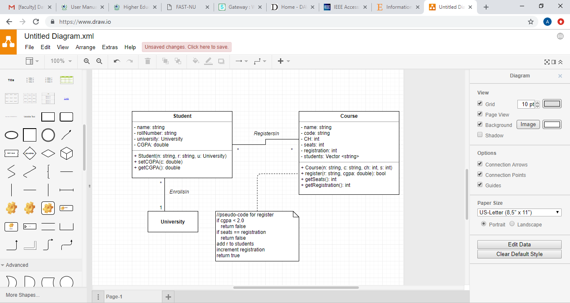
Modularity: Coupling: Control Coupling
  One component passes parameters to control the activity of another component
  The controlled component cannot function without direction from the controlling component
  Make each component perform only one function

Slide 13
Modularity: Coupling: Stamp and Data Coupling
Stamp coupling occurs when complex data structures are passed between modules
  Stamp coupling represents a more complex interface between modules, because the modules have to agree on the data’s format and organization
If only data values, and not structured data, are passed, then the modules are connected by data coupling
  Data coupling is simpler and less likely to be affected by changes in data representation
  Only data value is passed from one component to another
  Easiest to trace data and make changes
See Pressman for Type Use coupling

Slide 14
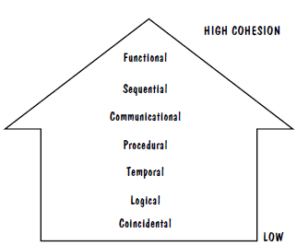
Modularity
Cohesion
  Measure of degree of independence of a module
  To what degree does the internal elements of a module are related
    E.g. data, functions etc.
  All elements contribute in performing a single task assigned to the module
  High cohesion is desired
Low cohesion is not desired

Slide 15
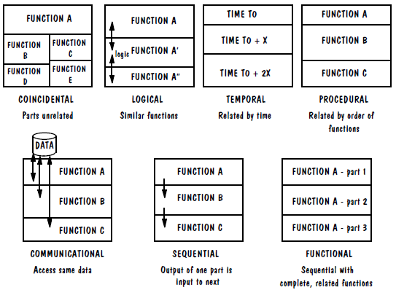
Modularity: Cohesion: Types of Cohesion

Slide 16
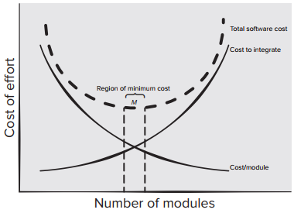
Modularity: Trade-off
Over modularization vs under modularization

Slide 17
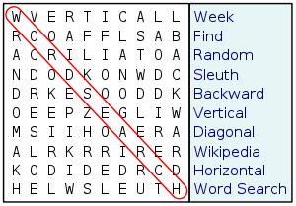
Separation of Concerns & Modularity (Revisited)
Intellectual control
Independent parts
7 ± 2 Rule
See Chapter 3 of Ghezzi, Chapter 2 of Hamlet

Slide 18
References
SE book by Ghezzi
SE book by Hamlet
SE book by Pfleeger
SE book by Pressman
https://www.educative.io/edpresso/what-are-the-different-types-of-coupling

